Slide 1

FRC Programming in wpilib
FRC Team 2059
By Mj
Co-Captain and Programming Lead

Slide 2

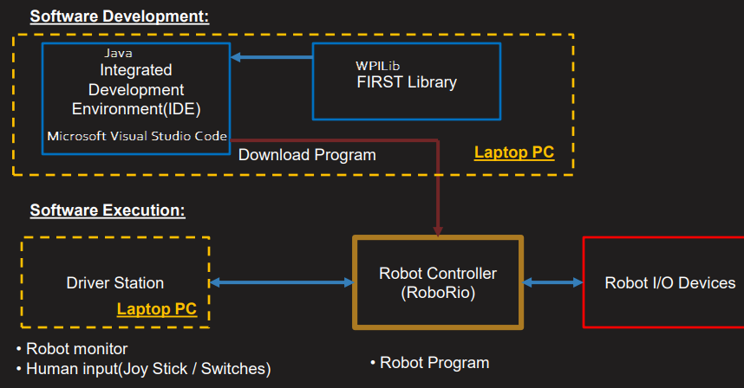
Tech Stack
WPI Library (abstracts hardware)
Java
MS Visual Studio IDE
http://cougartech.org/resources/Training/3-Engineering/CTSoft1-FRC%20Soft%20Design%20Process%20and%20Prog%20Structure.pdf

Slide 3
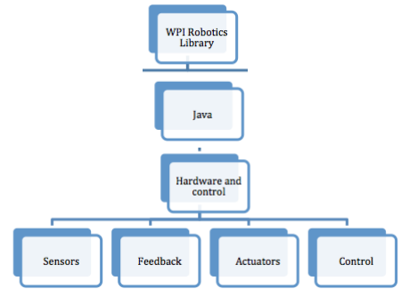
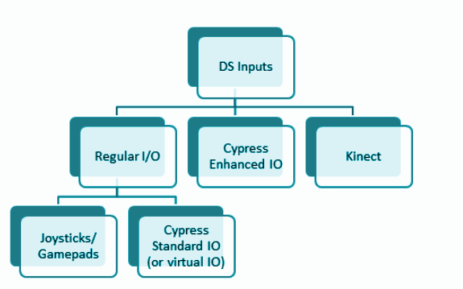
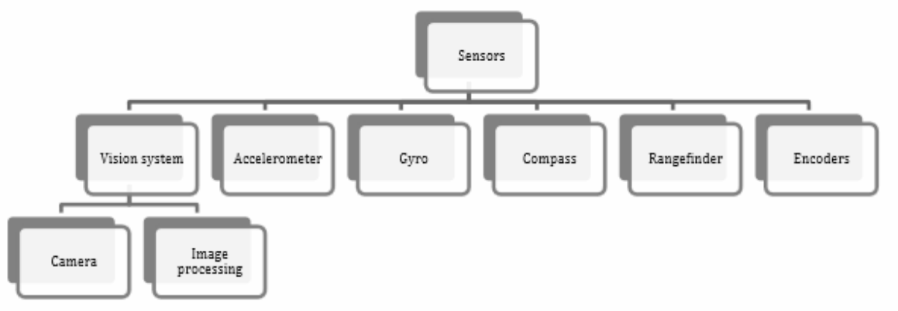
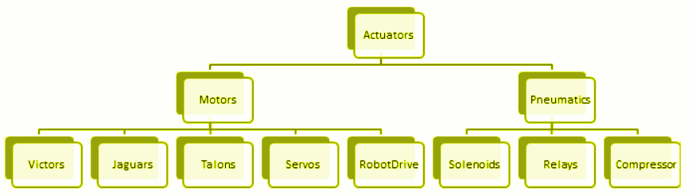
WPI Library
Gives you Sensors, Motors classes to work with so you don’t have to write device drivers
A gyroscope, or “gyro,” is an angular rate sensor typically used in robotics to measure and/or stabilize robot headings.
Encoders are devices used to measure motion (usually, the rotation of a shaft).
https://stemrobotics.cs.pdx.edu/sites/default/files/WPILib_programming.pdf

Slide 4
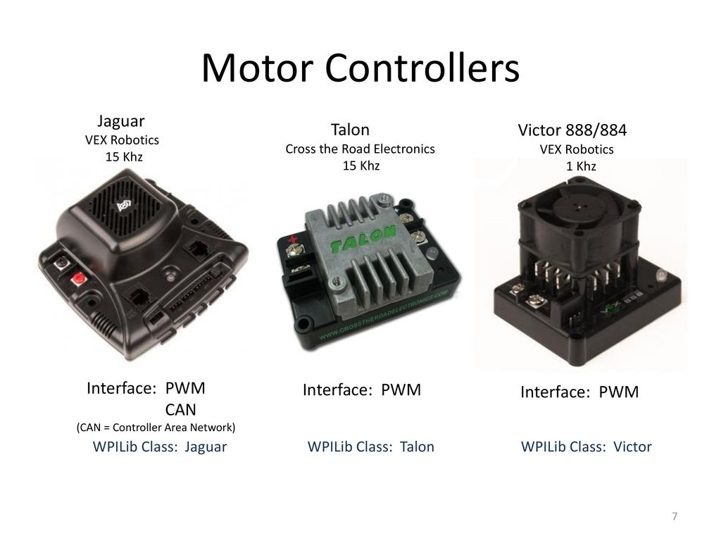
Motors

Slide 5
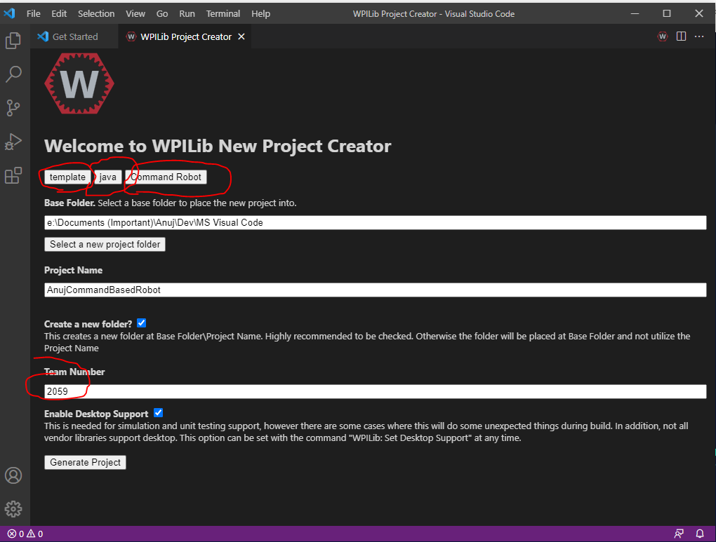
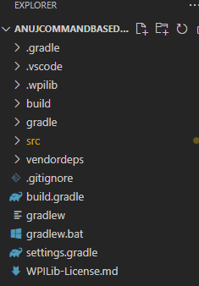
Installation and Command Based Robot (Sort of HelloWorld.java)
Use MS Visual Code IDE but distributed by WPI; instructions
Eclipse does not seem to be an IDE of choice WPILib in Eclipse
If there are issues installing turn off the antivirus temporarily
Listen to YouTube video to learn WPLIB in VS Code and how to use MS Visual Code
Fire up MS Visual Code and create a sample project with “WPI Template” to create a “Command Based Robot” in “Java” with team 2059
This will create a gradle (build) file along with a lot of template code

Slide 6
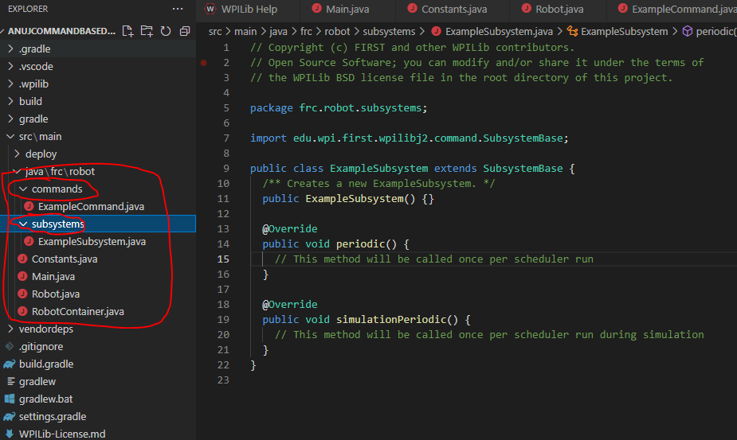
Command Based Robot : Auto Generated Code
So far we have auto-generated code (6 classes) based on the template we had selected.
Robot.java
RobotContainer.java
Constants.java
Main.java
ExampleCommand
ExampleSubsystem

Slide 7
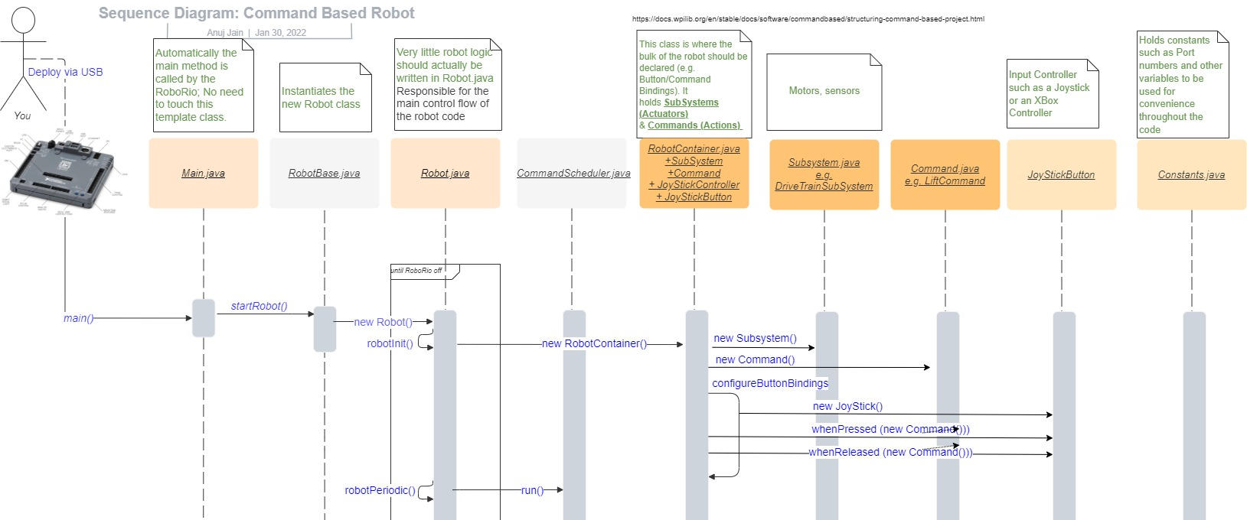
How does it work at a high level?
Who calls what and when? WIP….work in progress..
Command Based Robot Framework
Use DRAW.IO for Sequence Diagrams and Learn about Sequence Diagrams at https://creately.com/blog/diagrams/sequence-diagram-tutorial/
Structuring a Command-Based Robot Project https://docs.wpilib.org/en/stable/docs/software/commandbased/structuring-command-based-project.html

Slide 8
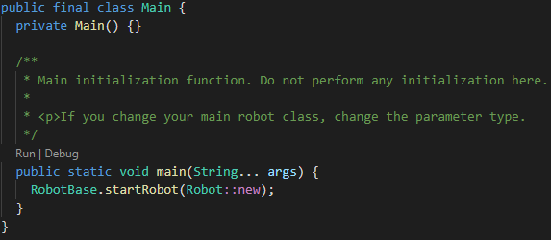
Main.java
Main entry point or the class
Its main method is called by RoboRio at start automatically; You never call it directly.
The main method instantiates your Robot.java by calling its constructor

Slide 9
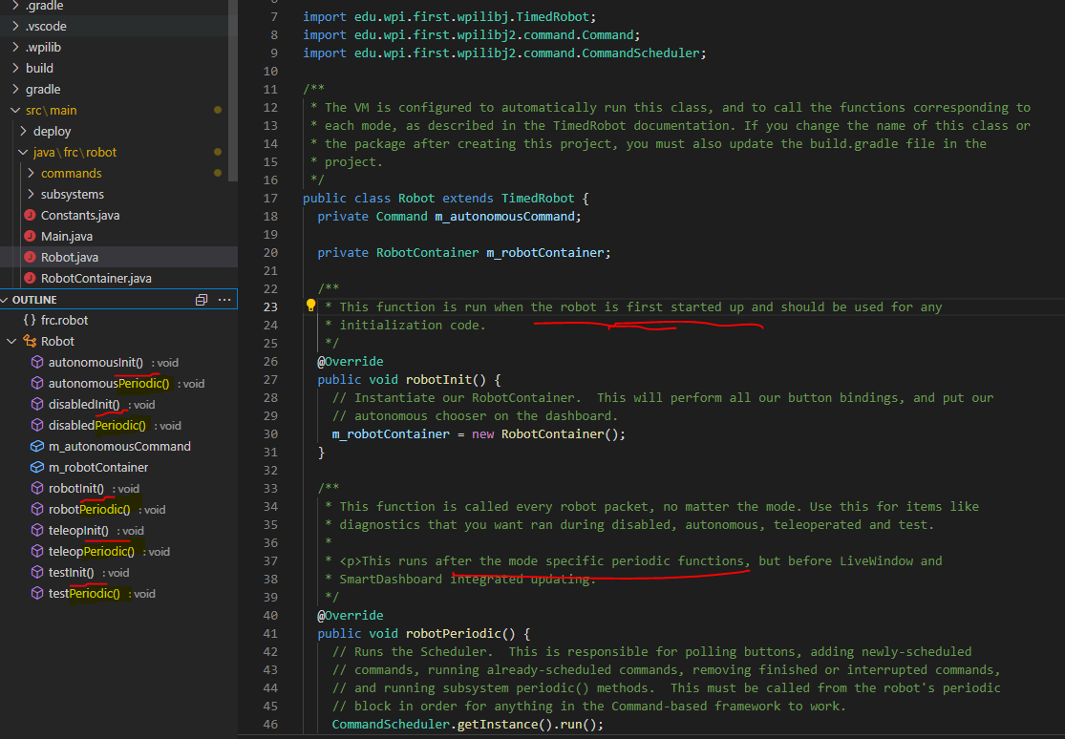
Robot.java: Understanding Generated Code
Primary Class that gets instantiated.
Two types of functions
Init()
Periodic()

Slide 10
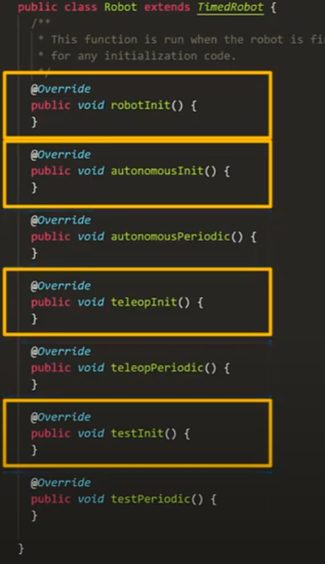
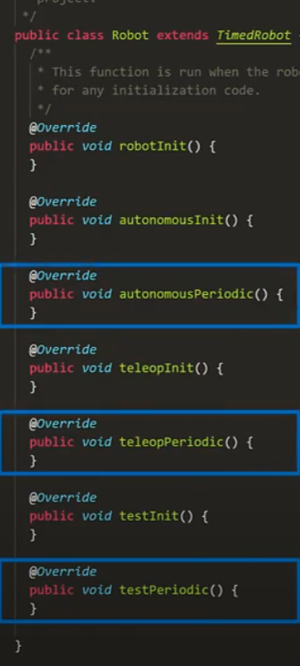
init()
periodic()
Robot.java: two types of functions
Initializing called once when the motor is started
are called repeatedly every 0.02 seconds TO updated the commands running on the robot

Slide 11
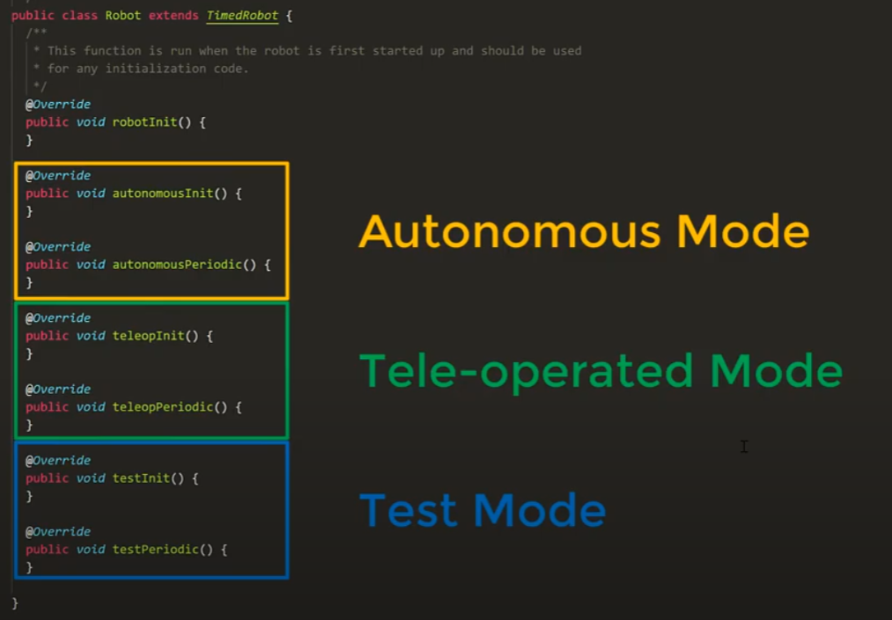
Robot.java: Depending on the Mode different methods are called

Slide 12
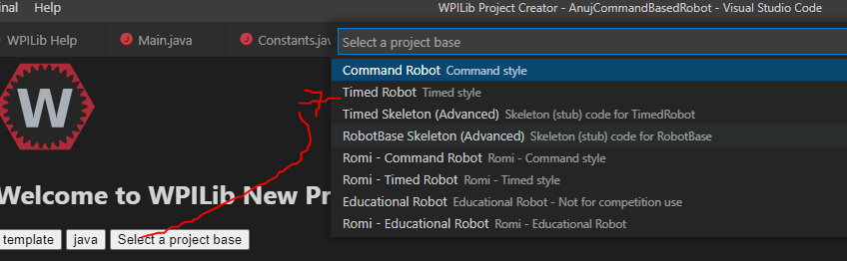
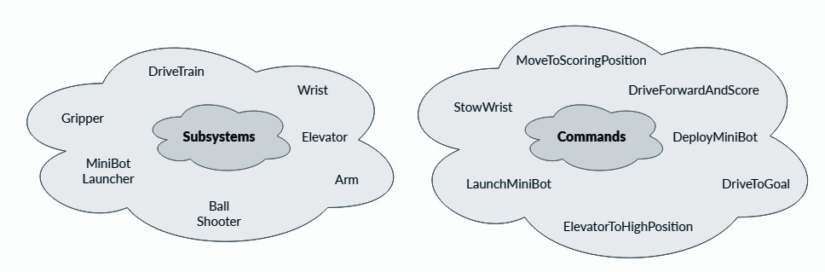
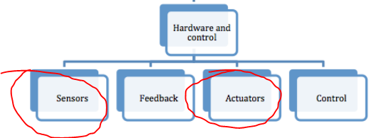
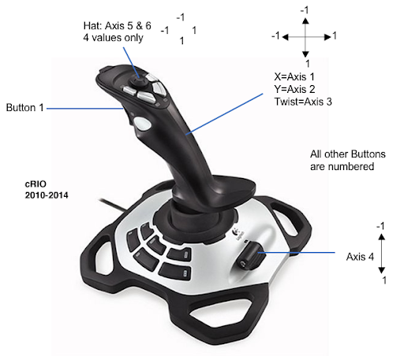
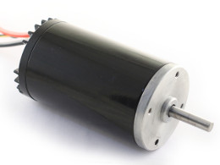
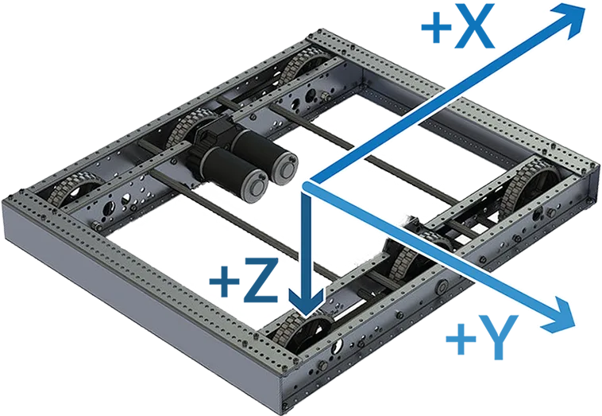
What Is a “Command-Based” Robot vs. Timed Robot or Iterative
Input (Joystick) and Output (Motor)
Essentially a design pattern (boilerplate framework/code) that reduces the amount of code one has to write to get a robot to do something.
This kind of robot is composed of two parts, viz., Command and Subsystem
You bind Commands in your code to an Input Controller (e.g. Joystick button)
You focus on “command” (actions) and “subsystem” (sensors or a motors) objects.
Subsystems represent the actual lower level hardware such as different types of Actuators (e.g. motors, pneumatic) and Sensors in your code. A subsystem can be a group of motors or sensors or just one motor or a sensor
Commands represent actions or behavior one wants to send to a subsystem. An action is either starting (initializing), executing, ending, or idle.
https://docs.wpilib.org/en/stable/docs/software/commandbased/what-is-command-based.html

Slide 13
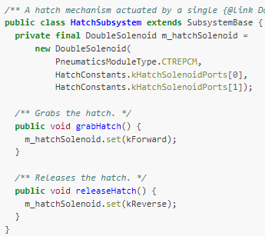
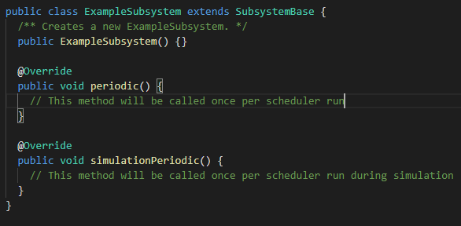
Subsystem (think hardware sensor or a motor or a composition of these)
You write methods to control hardware or read sensor values. E.g. grabHatch()
periodic() is run once per run of the scheduler
Works through the CommandScheduler
Can set default background commands that are run when nothing else is scheduled. E.g. keeping an arm held at a setpoint.
Is initialized via the Robot class methods (that are suffixed with init())
E.g. A Drivetrain subsystem will consist of a left Motor and a right Motor, along with the method setSpeed(double s)
Subsystems https://docs.wpilib.org/en/stable/docs/software/commandbased/subsystems.html

Slide 14

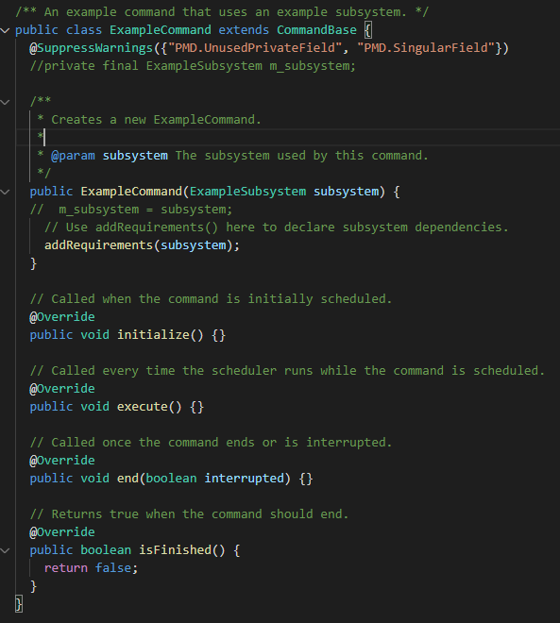
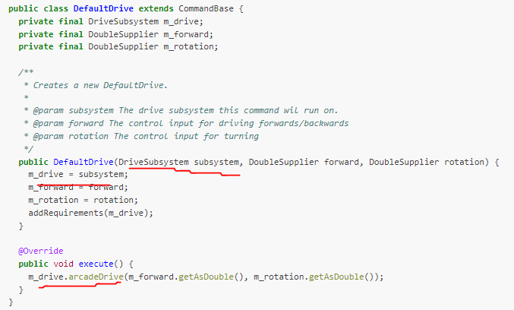
Command (think action on a motor or sensor or on a group/subsystem of these)
A 3 state machine
Knows about a SubSystem (takes it in constructor)
You fill in the templated methods
Calls Subsystem methods
The CommandScheduler will not schedule more than one Command for a SubSystem at a time.
initialize()
end()
execute()
Commands https://docs.wpilib.org/en/stable/docs/software/commandbased/commands.html

Slide 15
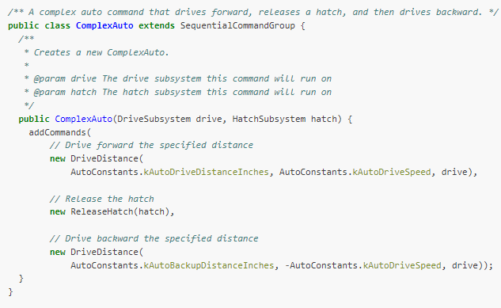
CommandGroups (think MULTIPLE COMMANDS GROUPED TOGETHER FOR EASE OF USE)
Working with 3 State commands can get cumbersome
A grouping of multiple commands to reduce complexity in programming
Takes in one or more Subsystems in constructor
Four types of templated groupings
SequentialCommandGroup
ParallelCommandGroup
ParallelRaceGroup
ParallelDeadlineGroup
Command Groups https://docs.wpilib.org/en/stable/docs/software/commandbased/command-groups.html

Slide 16
Joystick Button/Input Trigger: Binding to a Command
How do you run a command if not autonomous mode?
E.g. a button press by a human.
Solution: bind the command to this triggering event
Instantiate the actual hardware class that initiates input/trigger (e.g. XBOXController)
Bindings only need to be declared once, ideally some time during robot initialization. The library handles everything else.
In RobotContainer.java
// Creates a joystick on port 1
Joystick exampleStick = new Joystick(1);
// Creates a new JoystickButton object for button 1 on exampleStick
JoystickButton exampleButton = new JoystickButton(exampleStick, 1);
// Binds an ExampleCommand to be scheduled when the trigger of the example joystick is pressed
exampleButton.whenPressed(new ExampleCommand());
// Binds a BarCommand to be scheduled when that same button is released
exampleButton .whenReleased(new BarCommand());
Command Bindings to Triggers https://docs.wpilib.org/en/stable/docs/software/commandbased/binding-commands-to-triggers.html

Slide 17

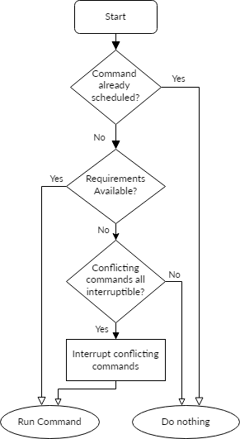
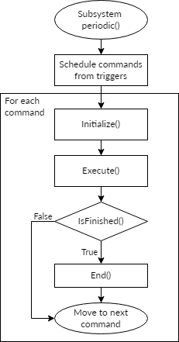
CommandScheduler
The run() Method
You call its schedule() to schedule a command; its initialize() method is called after getting added
Runs the actual commands automatically through the run() method
One call to run() is one iteration.
Each iteration (ordinarily once per 20ms), the scheduler execution occurs in the following order:
call Subsystem periodic() methods
poll the state of all registered triggers/buttons, get new commands
schedule new commands for execution
run the command bodies of all currently scheduled commands
check end conditions on scheduled commands and end those commands that have finished or are interrupted
Is a Singleton; use CommandScheduler.getInstance()
You never call its methods except to start (CommandScheduler.getInstance().run()) it from your Robot’s robotPeriodic()
Command Groups https://docs.wpilib.org/en/stable/docs/software/commandbased/command-scheduler.html
https://first.wpi.edu/wpilib/allwpilib/docs/release/java/edu/wpi/first/wpilibj2/command/CommandScheduler.html#run()

Slide 18
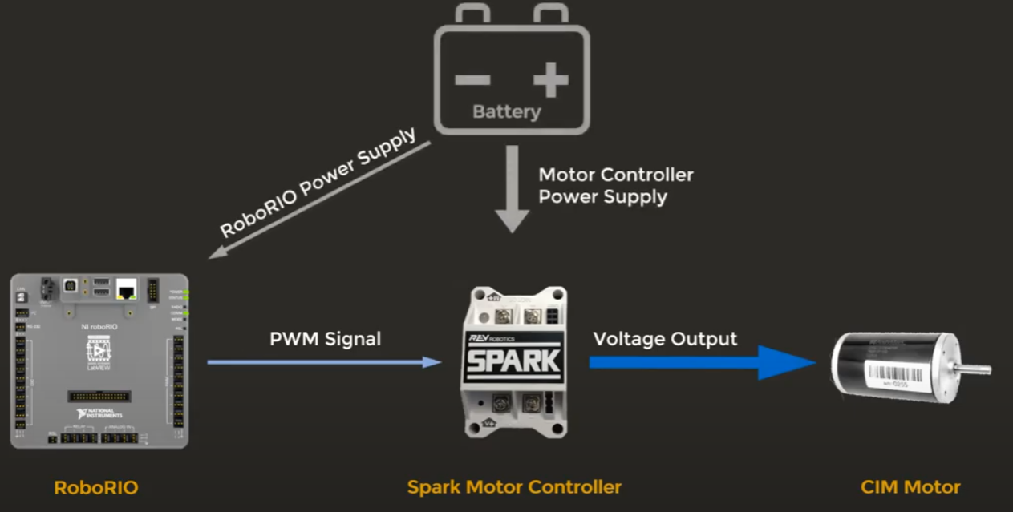
To control the Robot motor you need a Motor Controller
From Java code (burned in RoboRio) you can send a PWM signal to the Motor Controller telling it how fast to spin a motor
The motor controller will take the signal into a voltage output to the motor

Slide 19
What is a Motor
A type of an Actuator class in WPILib

Slide 20
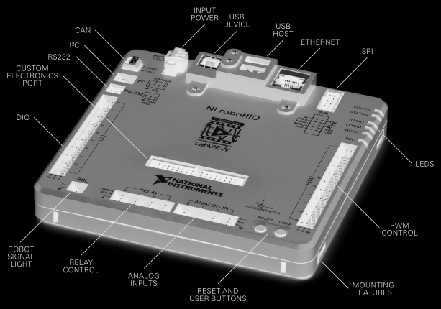
What is RoboRio
The brain of the robot where the code will be deployed and run
Headless, no GUI, need only a Jar
has many ports that are used in coding and for connecting to different devices
USB – to deploy code
CAN – used to control not only the pneumatics, but we use it for motor controllers that support CAN. CAN is the easiest way to wire things vs. using PWM, although at times we may use PWM too.
PWM – for Motor Controllers
DIO – to connect to sensors
MXP – for board expansion
SPI – for a gyro meter

Slide 21
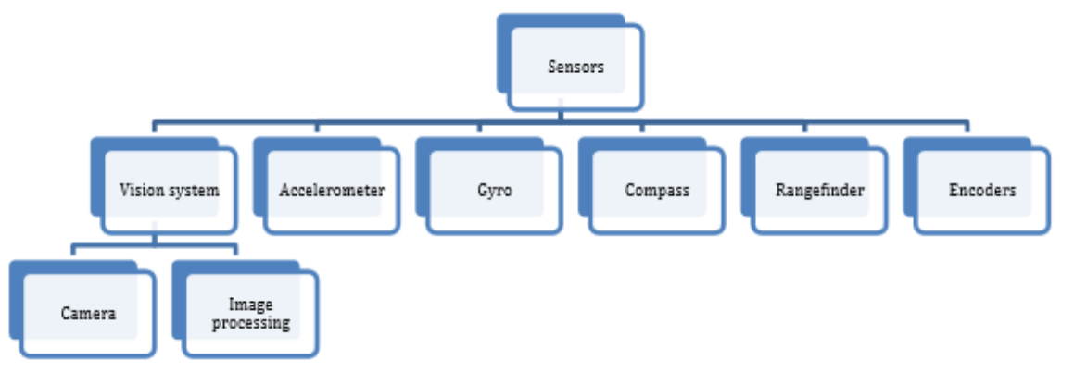
What is a Sensor
Many types such as
Camera
Encoder
To help robot understand its location and physical space around it

Slide 22
Java Coding Conventions

Slide 23
Java Coding Conventions
Use JavaDoc Documentation comments (/** * **/ to help you think about what the method does and help others understand what it is supposed to do without reading the code. A method encapsulates a behavior that one should be able to describe without needing to read the code.
Use Block comments (/* * */) and single line comments /* */), or end of line comments (//) to describe a variable or other parts of code
Do not use underscores in class or variable names
Once done coding, beautify your code
A variable name should be descriptive and
start with a lowercase letter following camel case. E.g. myDriveTrainSubsystem
A class name should be descriptive and
start with a capital letter following camel case. MyDriveTrainSubsystem
should include the name of the command or subsystem it is extending to help with self-documentation (E.g. TeleopCommand)

Slide 24
Java Coding Conventions…
A good practice would be to specify in Constants.java ports as constants. E.g.
Constants {
public static final int LEFT_MOTOR_PORT = 1;
public static final int RIGHT_MOTOR_PORT = 1;
public static final int JOYSTICK_PORT = 1;
public static final double PI = 3.14159;
}
Then you can access the variable in your code as Constants.LEFT_MOTOR_PORT
Note the upper case and underscores to define constants as static finals ; this is an exception to the regular nomenclature in java for naming variables/class
Also note that making it public will allow you to access the variable without getters/setters; again an exception to accessing the variables via methods as these are constants.
Two good programming resource Java for WPILib can be the folowing;; Keep in mind it might be a little outdated (2018)
https://frc6506.github.io/docs/Documents/Tome%20of%20Secrets.pdf
https://buildmedia.readthedocs.org/media/pdf/frc-pdr/latest/frc-pdr.pdf

Slide 25
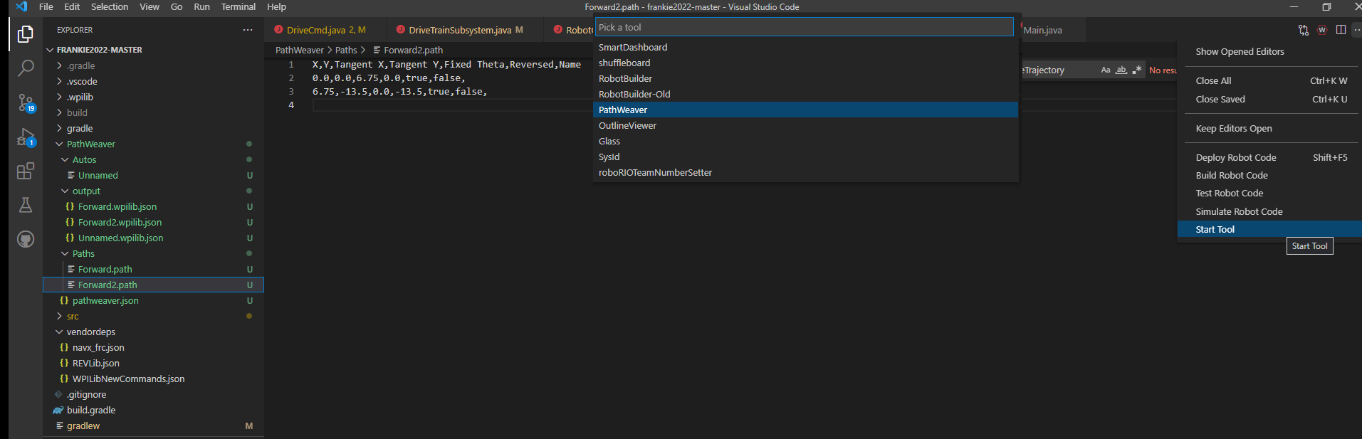
Visual Tools from Microsoft Visual Code
PathWeaver to visualize trajectories
RobotBuilder to build a robot and export code
RobotSimulator to simulate robot code

Slide 26
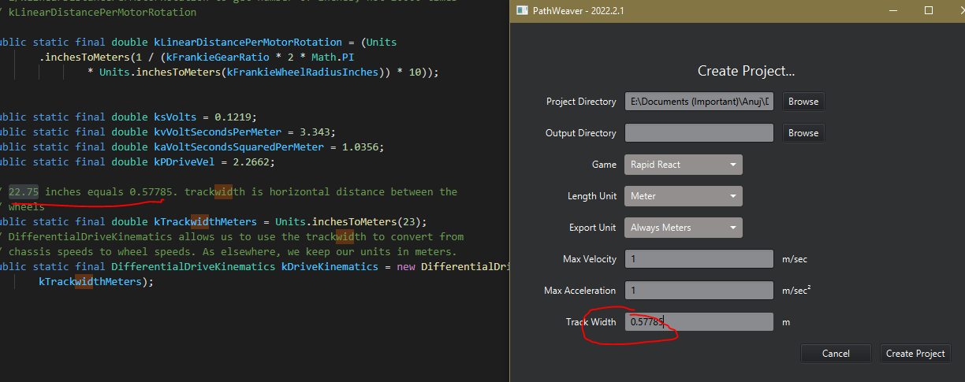
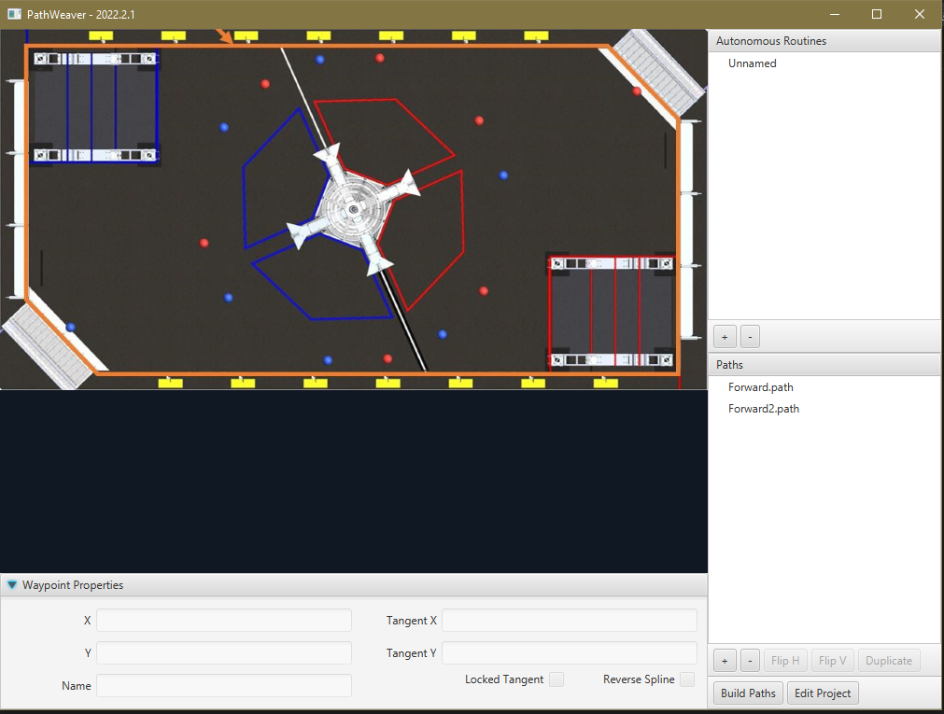
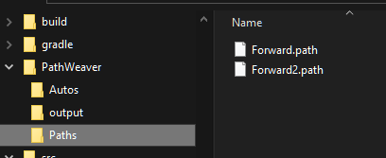
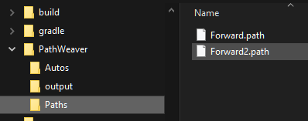
Pathweaver tool and declarative trajectory
PathWeaver tool/gui places .wpilib.json files in src/main/deploy/paths which will automatically be placed on the roboRIO file system in /home/lvuser/deploy/paths and can be accessed using getDeployDirectory
https://docs.wpilib.org/en/stable/docs/software/pathplanning/pathweaver/creating-pathweaver-project.html.

Slide 27
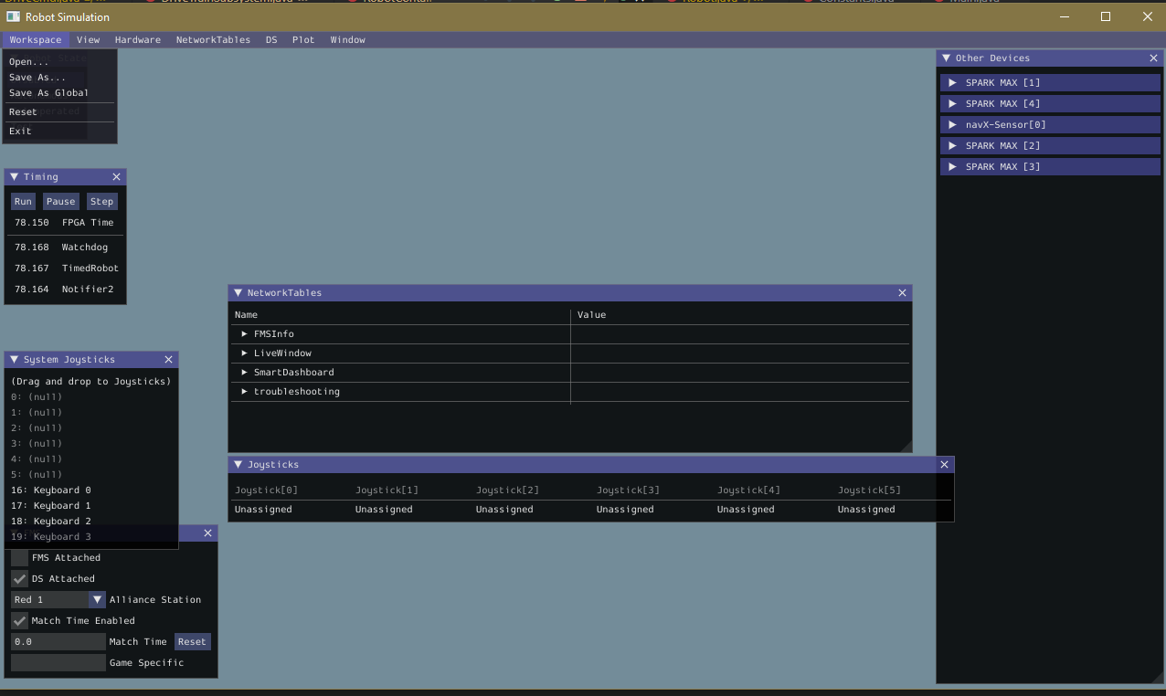
Robot Simulation tool
Used for Autonomous PID tuning

